Slide 1
EXECUTIVE SUMMARY
SaaS Customer Retention & Revenue Health Analysis
A data-driven investigation into the root drivers of customer attrition.
Combining subscription, support, and AI-classified exit interview intelligence.
Focused on reducing churn below 15% with actionable, evidence-based interventions.
95,090
19,811
20.83%
Total Customers
Churned Customers
Overall Churn Rate
Active subscription base analyzed across all plan tiers
Confirmed attrition events captured in the study period
Exceeds the 15% target threshold — immediate action required
3,368
Exit Interviews Analyzed
Unstructured interviews classified via AI for qualitative depth

Slide 2
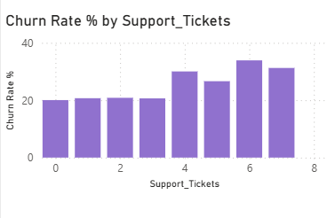
KEY FINDING 1 & 2
Subscription Tier Vulnerability & The 4-Ticket Churn Cliff
Key Finding 1 — Subscription Tier Risk Stratification
Key Finding 2 — Support Escalation Threshold
Churn rates vary meaningfully across plan tiers, revealing that lower-tier customers are significantly more susceptible to attrition. The data points to structural pricing and value-perception gaps at the entry and standard levels.
Support ticket volume is a leading indicator of churn risk. The data reveals a sharp, non-linear escalation in churn probability at the 4-ticket threshold — a critical intervention window.
22.16% — Basic Plans
Highest vulnerability tier. Customers on Basic plans exhibit the greatest churn risk, likely driven by limited feature access and poor perceived ROI at renewal.
22.18% — Standard Plans
Comparable risk profile to Basic. Standard plan customers face similar price sensitivity and unclear value differentiation from the tier above.
15.08% — Enterprise Plans
Significantly lower attrition. Higher switching costs, dedicated CSM relationships, and deeper product integration anchor Enterprise accounts effectively.
Churn holds near a ~20% baseline for accounts with 0–3 tickets, then spikes sharply to 30.04% at 4 tickets and reaches 33.90% for accounts with 6 or more — a 69% relative increase over baseline.

Slide 3
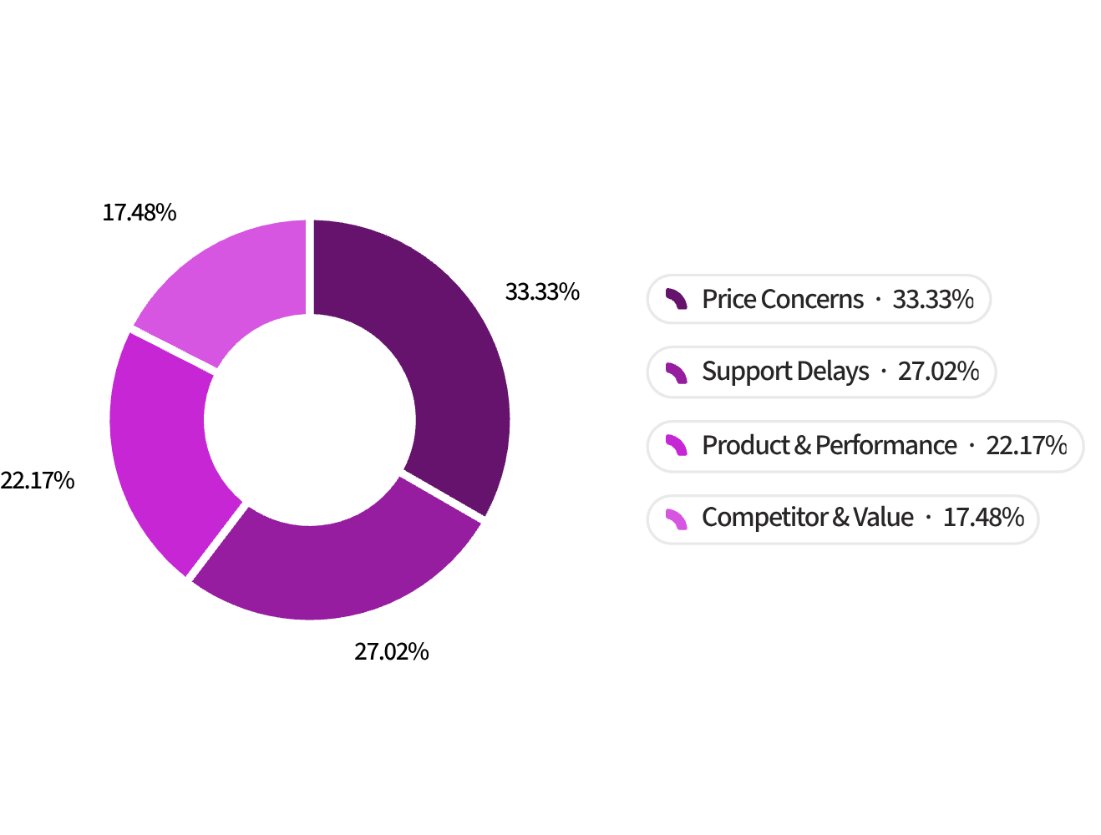
KEY FINDING 3
AI Exit Interview Classification
Top Drivers of Attrition
Analysis of 3,368 exit interviews identified four dominant reasons customers leave.
Price Concerns — 32.9%
Support Delays — 26.7%
1,108 customers
898 customers
Product & Performance Issues — 21.9%
Competitor & Value Switching — 17.2%
737 customers
581 customers
Price and support account for 59.6% of all exit reasons.

Slide 4


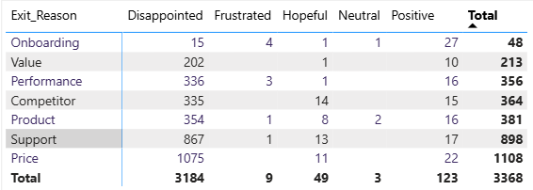
KEY FINDING 4
Emotional Analysis — The Disappointment Factor
94.5%
Disappointment
1,075 Customers
Price × Disappointed
Largest pairing. Renewal pricing felt unexpected, not inflammatory.
867 Customers
3,184 of 3,368 departing users expressed disappointment as their primary emotional state.
This churn was not driven by sudden anger — it built quietly over time as expectations went unmet.
Support × Disappointed
Unmet expectations in technical assistance eroded trust over time.
94.5%
32%
Disappointment
Price-Driven
Primary emotion across exit interviews
Of disappointed customers, price was the trigger

Slide 5
EXECUTIVE ACTION PLAN
3 Pillars to Lower Churn Below 15%
Three high-leverage interventions tied directly to the analysis findings, designed to reduce churn through faster escalation, clearer pricing, and stronger support execution.
Pillar 1 — 3-Ticket SLA Trigger
Pillar 2 — Pricing Restructure
Rooted in: the 4-ticket churn cliff
Rooted in: price-driven churn and Basic/Standard attrition
Trigger CSM alerts at the 3rd ticket
Escalate before the 4-ticket threshold
Treat every 3-ticket account as a retention risk
Add month-to-month billing for lower tiers
Simplify value messaging at renewal
Use targeted discounts for at-risk accounts
Pillar 3 — Support Overhaul
Rooted in: support-driven churn and disappointment
Improve self-service and knowledge base content
Shorten resolution times
Add post-resolution satisfaction checks
Target Outcome
Measurement Framework
Reduce churn from 20.83% to below 15%, retaining 5,600+ customers annually at current volume.
Track churn by tier monthly. Monitor 4-ticket breaches as a leading indicator. Re-run exit interview classification quarterly. Benchmark support resolution time against churn cohorts.

